Slide 1
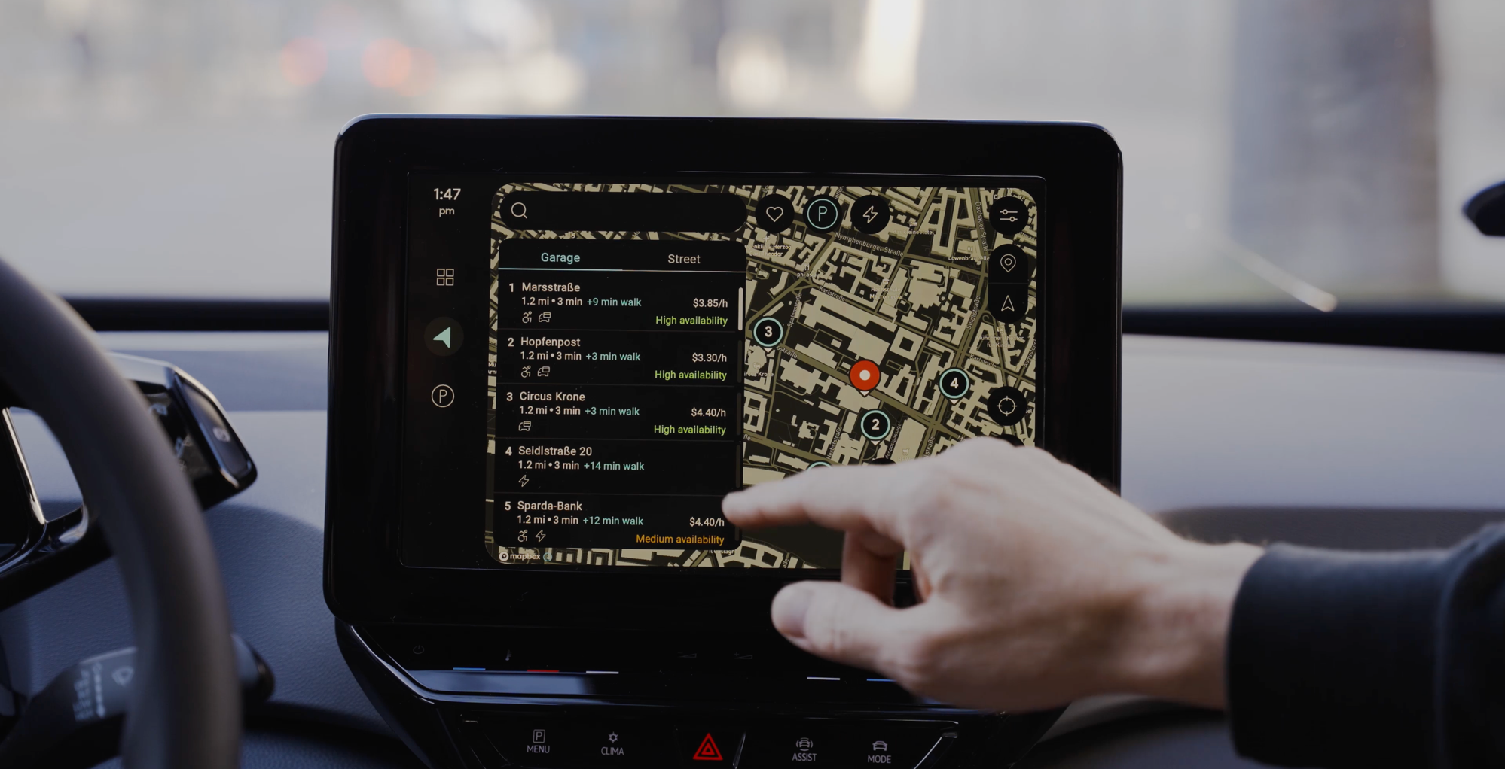
Team Wise Riders ThreadX loves uProtocol
Eclipse SDV
Hackathon Chapter Two

Slide 2
ThreadX
Loves
uProtocol
Challenge: To ThreadX and Beyond!
Problem / initial situation:
uProtocol (UP) enables unified service mesh and message / signal communication - but misses lower level support for devices like Microcotroller
ThreadX is powerful and lightweight RTOS for Microcontroler
Vision: Teach ThreadX (TX) talking uProtocol (UP)
Mission:
Understand TX and MXChip/AZ3166
Remote Honk & Flash
Crash Detection
Unique Selling Point (USP):
unified and complete software stack
unified by uProtocol Message standard
covers high computing and low level devices
UP
TX

Slide 3
Bendik Illich – uProtocol Rust / Backend
Jan Jongen – uProtocol MXChip, Documentation
Matthias Busch – MXChip Views / Modes, Android Application
Oliver Thailmair – MXChip Views / Modes
Daniel Elhs - MXChip Views / Modes, Presentation
Wise Riders

Slide 4
Our
Approach
Utilize MXChip/AZ3166 including codebase provided by coaches (Frederic)
Display & LEDs
Logger (MacOS / CoolTerm)
C Programming
uProcol message specification
MQTT / Protobuf
Leverage and extend existing uProtocol codebase
Simulates HPC or Cloud
Android Demo App
Triggers Honk & Flash
Receives Crash Detection event

Slide 5
Off-Board (HPC / Cloud)
MXChip / AZ3166
Android App
H&F
Rust - uProtocol
H&F
uProtocol@TX
Modes / Views
CD
CD
Board Capabilities
H&F
CD
Honk & Flash
Crash Detection
Log View @ MacOS
H&F = Honk & Flash
CD = Crash Detection

Slide 6
Off-Board (HPC / Cloud)
Focus on Technology
MXChip / AZ3166
Focus on
Creativity
Killer
Feature!
Android App
H&F
Rust - uProtocol
H&F
uProtocol@TX
Modes / Views
CD
CD
Board Capabilities
H&F
CD
Honk & Flash
Crash Detection
Log View @ MacOS
H&F = Honk & Flash
CD = Crash Detection

Slide 7
Achievement
And
Learnings
Achievements
End-2-End running software (Demo!)
MQTT – uProtocol – ThreadX@MXChip
Good understanding of TX essentials
Lot of fun with MXChip/AZ3166
Deliveries
C-Code & ThreadX@MXChip Image
Rust-Code uProtocol Application
Simple Android Application
Documentation
Challenges
New technical area: Microcontroller and C
MQTT Client/uProtocol → see documentation for more details
Development and testing strategy – regular small increments of running software + manual tests
Networking issues with Android Devices
Learnings
Essential understanding how uProtocol works on ThreadX / Microcontroller
Satisfaction with the outcome, but still way to go for production readiness and safety
Good code foundation from Frederic – THX!

Slide 8
Market
And
Competition
Market
Technological proof of concept for an extended open source software stack
Don‘t get tired convincing the market about the power of open source ;-)
Competition
Well known closed source software stacks

Slide 9
Busines Model, Plan
And
Funding requirements
„Business Model“
Consultancy / Professional services on open source utilization
Attract OEMs by
Cost saving due to utilization of open source standards and components
Shorter Time to Market
Shorter innovation cycles
„Business Plan“
attract community:
Contribution to existing projects
Contribution to blueprint or new blueprint
Demos on real hardware
Win an OEM as first partner
Establish ThreadX and uProtocol as successful software stack
Potential funding reuirements
Developer support to proceed next steps
Marketing campaign to address OEMs
Maintenance
Potential Funding Contacts
CTOs, technical Managers / lead Architects, SDV departments

Slide 10
Thank you ☺
Meet us on Eclipse SDV touchpoints, linkedin…

